Slide 1

AWS PROJECT
Topic: Mass Emailing using AWS Lambda

Slide 2
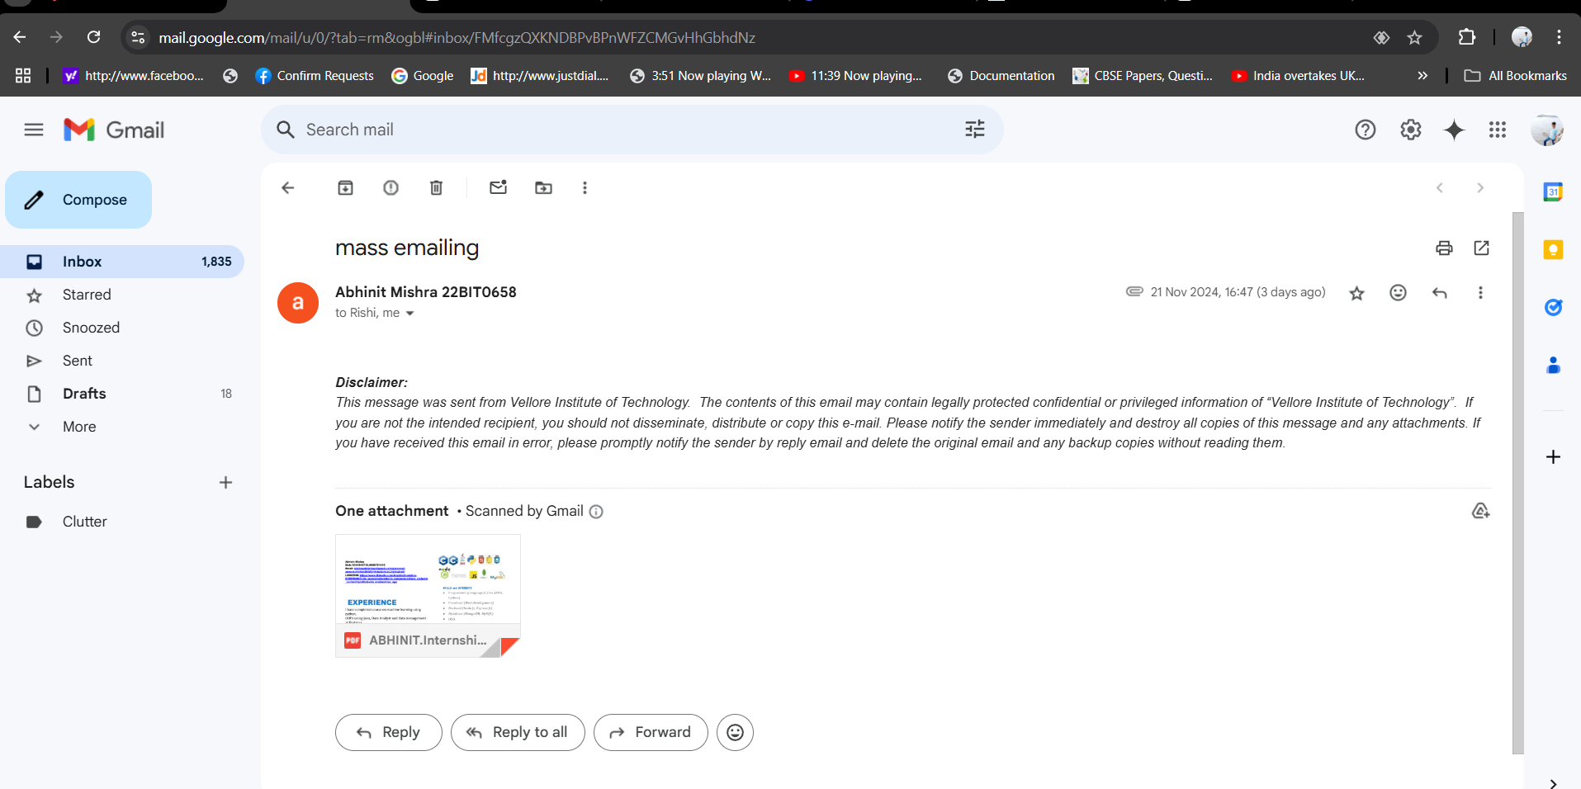
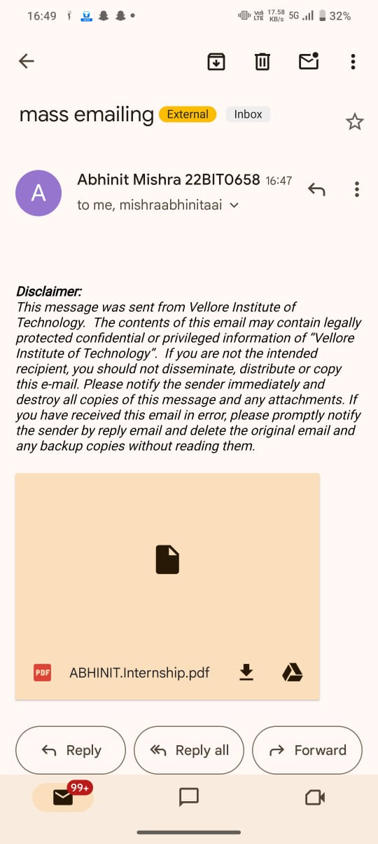
Project Overview
As we all know that for an organization they cannot send an email to a vast majority at once by just adding recipients. So instead of using the traditional oldschool way, the organization authenticates the e-mail address and provide that to the users on which we can send email at once

Slide 3

The Problems Faced
Challenges in Mass Emailing:
High operational costs of traditional servers.
Scalability issues during peak loads.
Managing deliverability and compliance (e.g., spam regulations).
Objective:
Implement a cost-effective, scalable, and serverless solution for sending mass emails.

Slide 4

SOLUTION
AWS Lambda-based Mass Emailing:
Serverless: No need to manage servers.
Scalable: Handles millions of requests seamlessly.
Integration: Works with Amazon SES (Simple Email Service) for email sending.

Slide 5

Architecture
Trigger Source:
S3 bucket upload
Scheduled event using CloudWatch
AWS Lambda:
Processes the email data and calls Amazon SES.
Amazon SES:
Sends the email to recipients.
DynamoDB/CloudWatch Logs (optional):
Tracks email status.
SNS (Notifications) (optional):
Sends alerts on email delivery status.

Slide 6
TECHNICAL DETAILS
AWS Lambda:
Runtime: Python/Node.js
Event-driven execution (e.g., from S3 or CloudWatch).
Amazon SES:
Handles email sending and compliance.
Configured with verified sender domains.
Security:
IAM roles and policies for restricted access.
Data encryption using KMS (if necessary).

Slide 7

WorkFlow
Prepare an email list (CSV uploaded to S3).
Lambda function reads the CSV and processes records.
Send emails via SES in batches to avoid throttling.
Log email delivery status to CloudWatch.

Slide 8
Key Benefits
Cost-Effective: Pay only for execution time and emails sent.
High Scalability: Automatic scaling based on load.
Ease of Management: Fully managed services reduce operational overhead.
Compliance: Built-in tools for handling spam and domain verification.

Slide 9
Challenges and Mitigations
Throttling in SES: Implement rate limits using delays in Lambda.
Email Deliverability: Configure SPF, DKIM, and DMARC for domain authenticity.
Error Handling: Retry mechanisms and logging in Lambda.

Slide 10

Conclusion and Future Enhancements
Summary:
Serverless, scalable, and cost-efficient emailing solution.
Future Enhancements:
Implement analytics using QuickSight.
Personalization using ML models (Amazon Personalize).

